Slide 1


Slide 2


Introduction to C++ and Object Oriented Programming
Polymorphism to C++
Type of polymorphism
Compile time polymorphism
Method Overriding in C++
Method overloading
Run time polymorphism
Virtual Function in C++
References

Slide 3
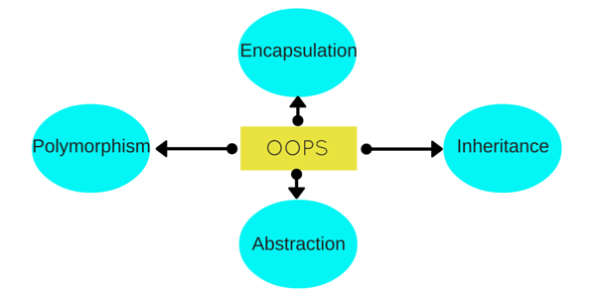
C++ and Object Oriented Programming
Object Oriented programming is a programming style that is associated with the concept of Class, Objects and various other concepts revolving around these two, like Inheritance, Polymorphism, Abstraction, Encapsulation etc.

Slide 4
Oops Concept in C++
OBJECTS -Objects are the basic unit of OOP. They are instances of class, which have data members and uses various member functions to perform tasks.
CLASS -It is similar to structures in C language. Class can also be defined as user defined data type but it also contains functions in it.
ABSTRACTION -Abstraction refers to showing only the essential features of the application and hiding the details.

Slide 5
Encapsulation -It can also be said data binding. Encapsulation is all about binding the data variables and functions together in class.
Inheritance
Inheritance is a way to reuse once written code again and again. The class which is inherited is called base calls & the class which inherits is called derived class. So when, a derived class inherits a base class, the derived class can use all the functions which are defined in base class, hence making code reusable.
Polymorphism
It is a feature, which lets us create functions with same name but different arguments, which will perform differently. That is function with same name, functioning in different way. Or, it also allows us to redefine a function to provide its new definition. You will learn how to do this in details soon in coming lessons.

Slide 6
Polymorphism in C++
The process of representing one Form in multiple forms is known as Polymorphism.
Here one form represent original form or original method always resides in base class and multiple forms represents overridden method which resides in derived classes.
Polymorphism is derived from 2 Greek words: poly and morphs. The word "poly" means many and morphs means forms. So polymorphism means many forms.

Slide 7
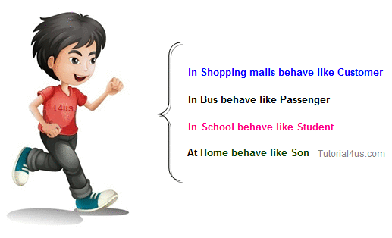
Real life example of Polymorphism in C++
Suppose if you are in class room that time you behave like a student, when you are in market at that time you behave like a customer, when you at your home at that time you behave like a son or daughter, Here one person have different-different behaviors.

Slide 8
Type of Polymorphism
Compile time polymorphism
Run time polymorphism

Slide 9
Compile time polymorphism
In C++ programming you can achieve compile time polymorphism in two way, which is given below;
Method overloading
Method overriding

Slide 10
Method Overloading in C++
Whenever same method name is exiting multiple times in the same class with different number of parameter or different order of parameters or different types of parameters is known as method overloading.

Slide 11
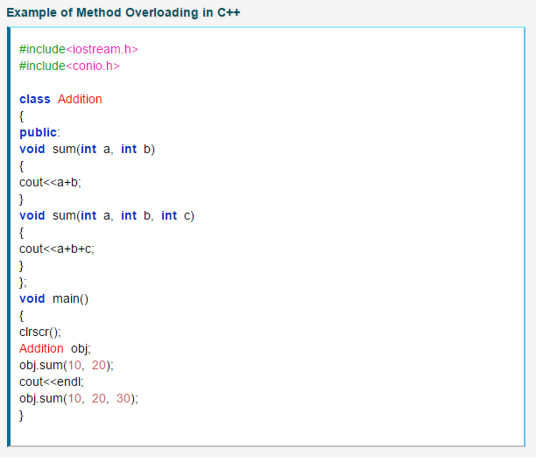
FIGURE 1:Example of Method Overloading in C++

Slide 12
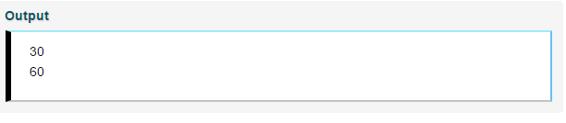
FIGURE 2:OUTPUT

Slide 13
Method Overriding in C++
Define any method in both base class and derived class with same name, same parameters or signature, this concept is known as method overriding. In below example same method "show()" is present in both base and derived class with same name and signature.

Slide 14
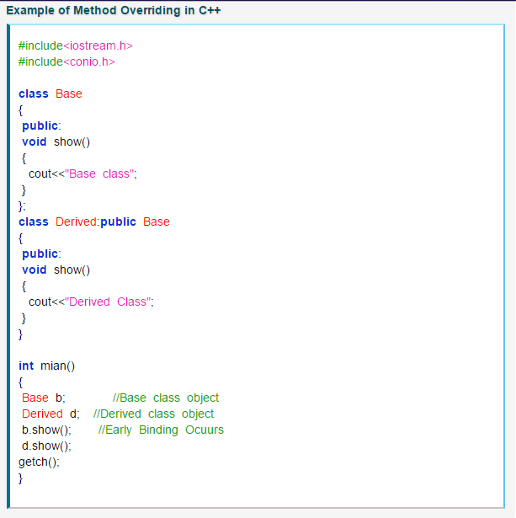
FIGURE 3:Method Overriding in C++

Slide 15
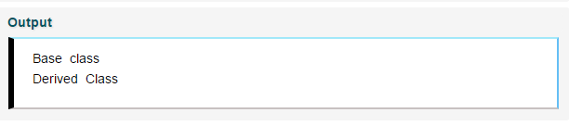
FIGURE 4:Output

Slide 16
Run time polymorphism
In C++ Run time polymorphism can be achieve by using virtual function.
It works by means of an indirect call, calling a virtual member function of a base object by means of reference or a pointer to what is actually a derived object re-implementing the virtual functions.

Slide 17
Virtual Function in C++
A virtual function is a member function of class that is declared within a base class and re-defined in derived class.
When you want to use same function name in both the base and derived class, then the function in base class is declared as virtual by using the virtual keyword and again re-defined this function in derived class without using virtual keyword.

Slide 18
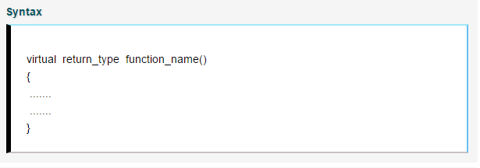
FIGURE 5: SYNTAX FOR Virtual Function in C++

Slide 19
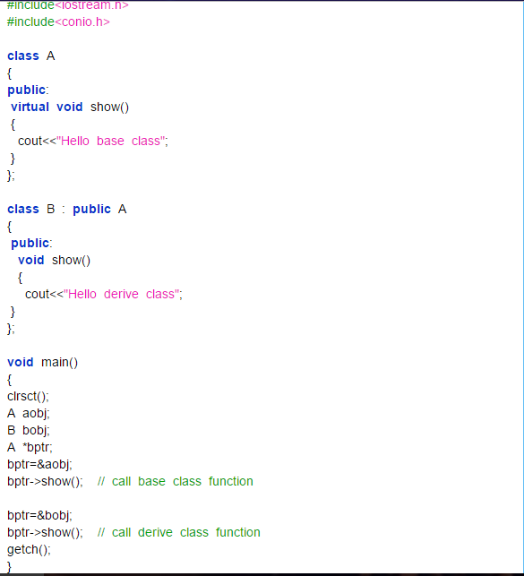
FIGURE 6:Example of Method Overriding in C++

Slide 20
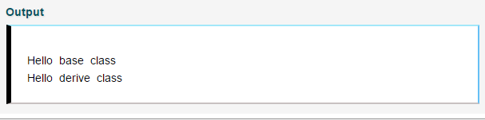
FIGURE 7: Output

Slide 21
Classwork :
Q.1) Write a c++ program to create class TriPeri to calculate Perimeter of triangle, function named as peri() and inherit class TriPeri in class RectPeri to calculate perimeter of rectangle, function name as peri().
TriPeri-(peri())
RectPeri-(peri())
Identify which of inheritance? single
Which type of polymorphism it is? Runtime
How to implement the same? virtual

Slide 22


